Slide 1




K.S.RANGASAMY COLLEGE OF TECHNOLOGY
(Autonomous)
Tiruchengode – 637 215
Department of Computer Science and Business Systems
Task Management System
Presented by
MUGESH KARTHI G S (73772227130)
DHARANISH N (73772227107)
PRAVEEN C V (73772227136)
IV Year/CSBS

Slide 2
INTRODUCTION
The Task Management System is a secure and user-friendly web platform designed to streamline task organization and team collaboration. It allows users to create, assign, and track tasks, update progress, and manage deadlines, while administrators can oversee all users, monitor project status, and configure system settings. The system automates task tracking, ensures data security, and improves productivity by providing real-time updates and efficient workflow management.
2

Slide 3
PROBLEM STATEMENT
Manual task management causes inefficiencies, delays, and security risks.
Misplaced Tasks: Important tasks overlooked or forgotten, causing missed deadlines.
Tracking Errors: Incorrect task status updates leading to confusion and rework.
Unauthorized Access: Sensitive project data modified by unauthorized personnel.
Processing Delays: Slow coordination and approval processes delaying project completion.
3

Slide 4
FEATURES
User Portal: Secure login, profile updates, create and manage personal tasks. Admin Dashboard: User onboarding, project creation, task assignment, and overall management. Task Management: Add, edit, delete, and track task progress in real time. Security: Role-based access control and encrypted data storage. Responsive Design: Works seamlessly across desktops, tablets, and smartphones. Productivity Tools: Automated progress tracking, deadline reminders, and quick access to task details.
4

Slide 5
TECHNOLOGY STACK
Backend: Spring Boot (Java) – API development and security.
Frontend: React – Dynamic and responsive UI.
Database: MySQL – Relational storage for tasks data.
Tools: Maven, Git, Postman, Visual Studio Code.
5

Slide 6
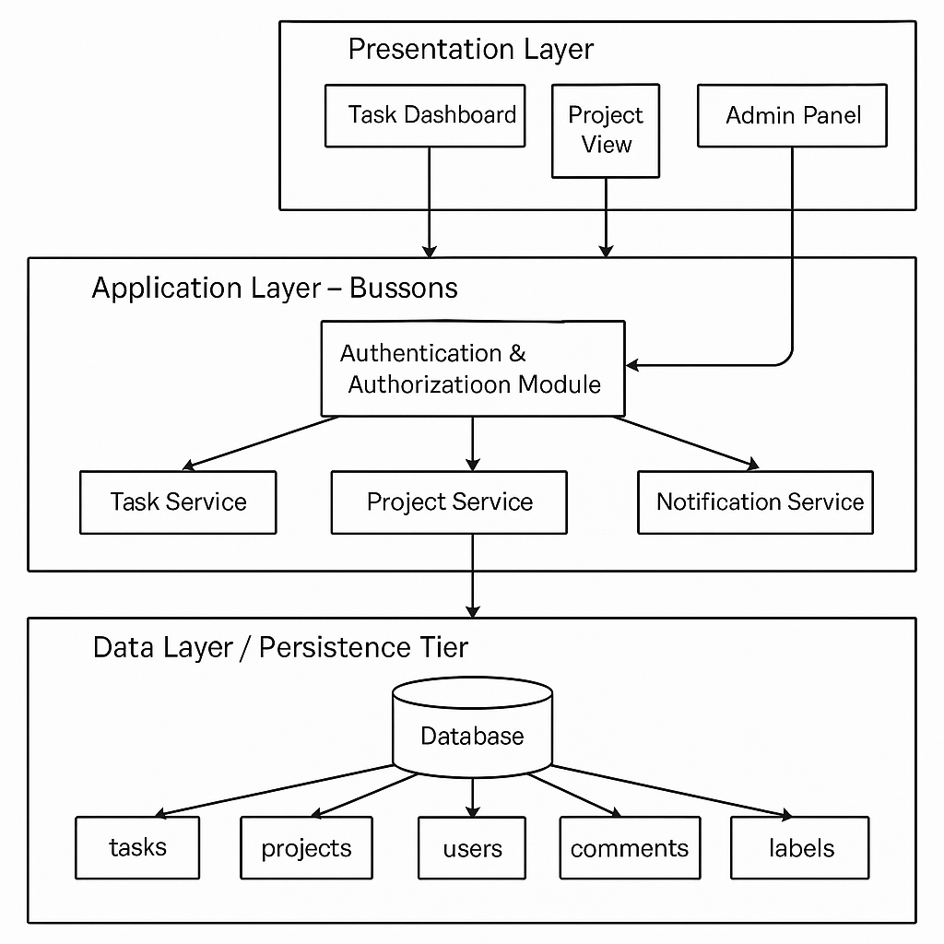
SYSTEM ARCHITECTURE
Three-Tier Model:
Presentation Layer: React.js frontend providing a responsive and user-friendly interface, connected through REST APIs.
Application Layer: Spring Boot backend managing request handling, authentication, and data operations.
Data Layer: MySQL database storing all application data securely and efficiently.
6

Slide 7
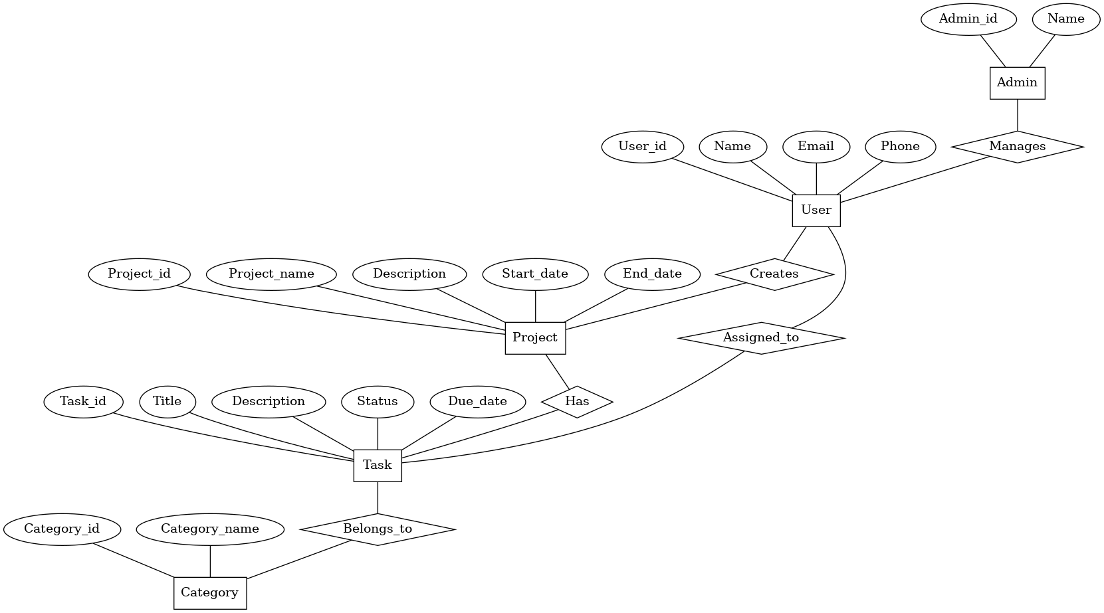
ER DIAGRAM
7

Slide 8
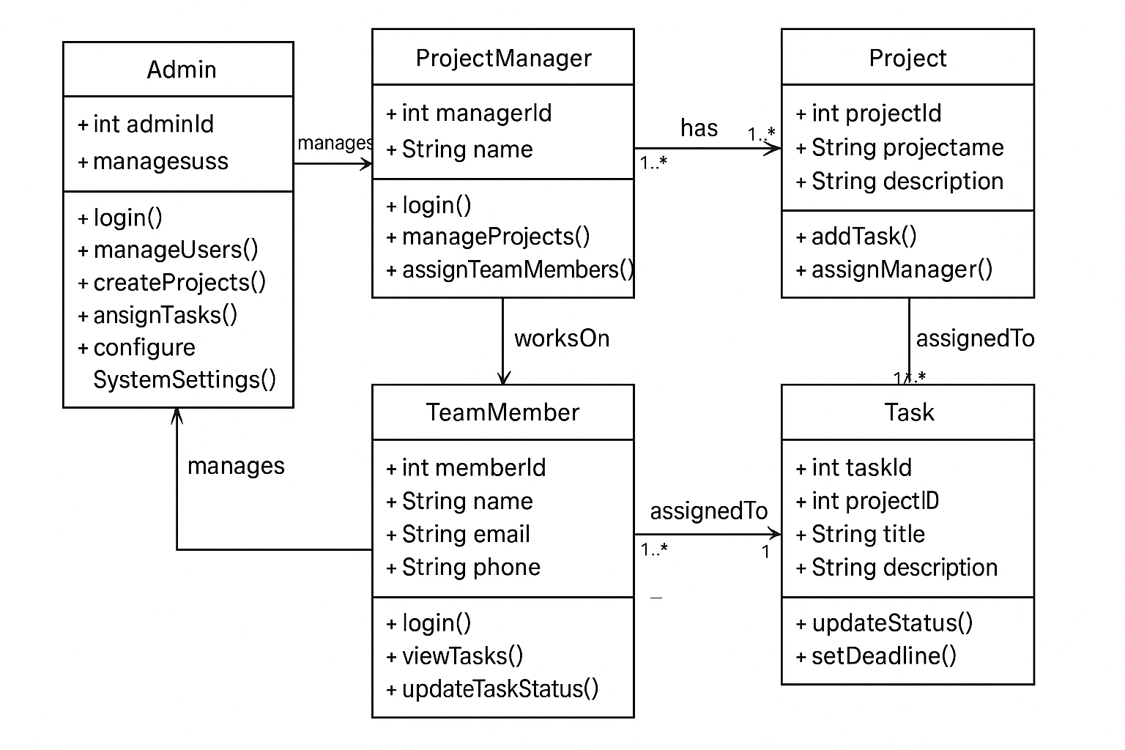
UML DIAGRAM
Class diagram:
9

Slide 9
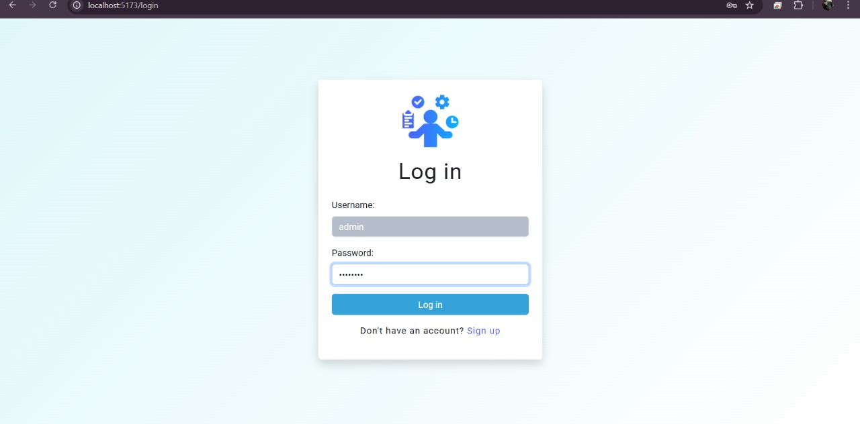
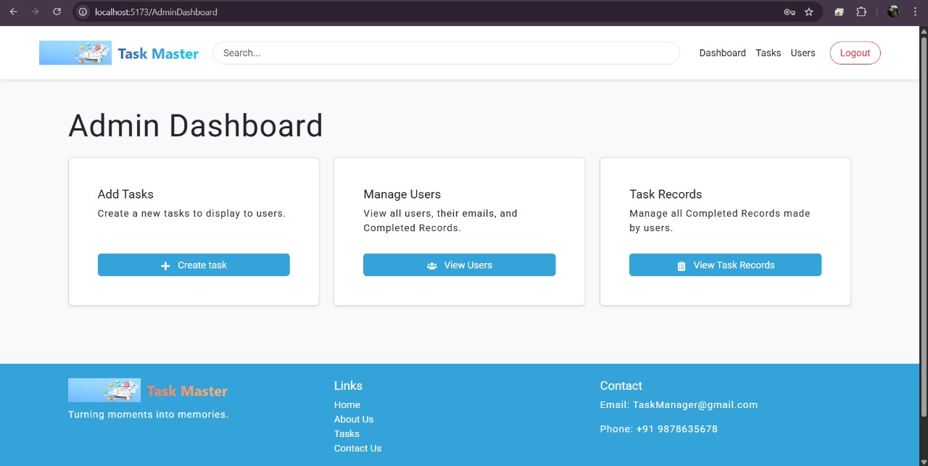
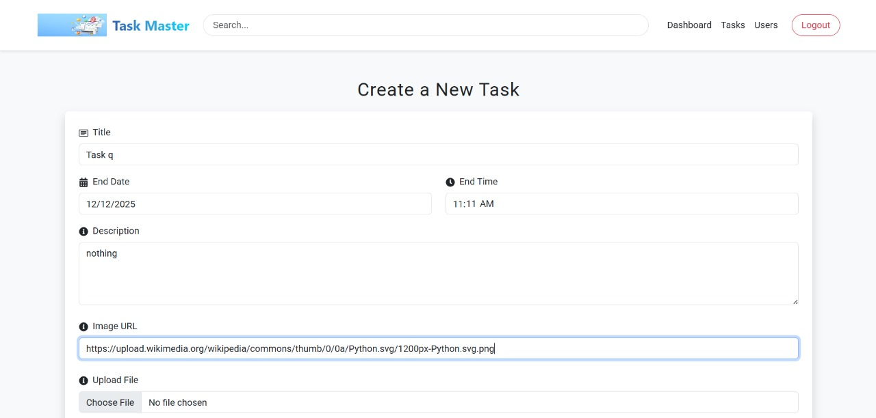
PROJECT SAMPLES
11

Slide 10
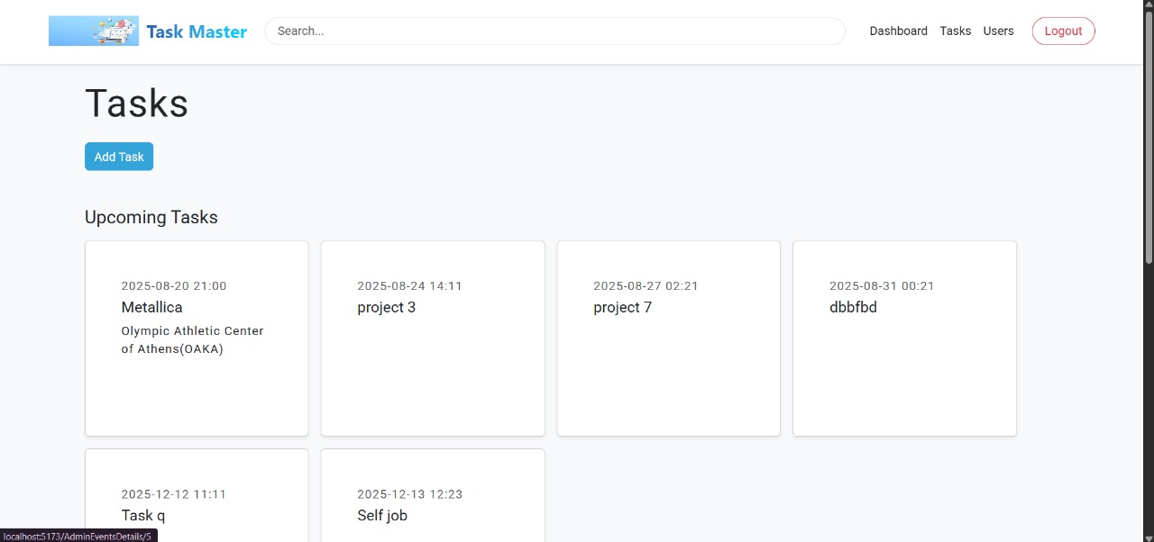
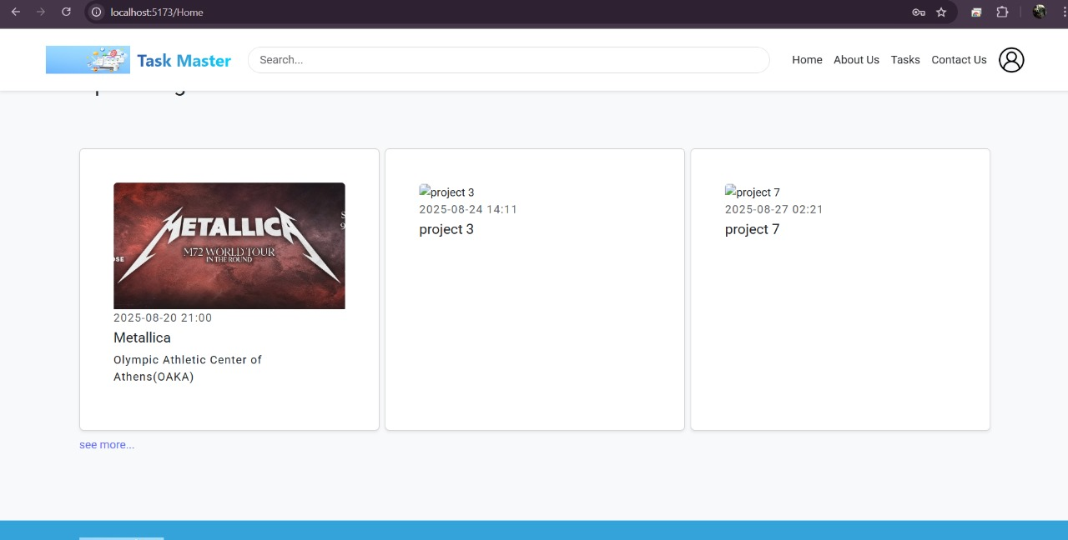
PROJECT SAMPLES
11

Slide 11
CHALLENGES FACED
Creating an intuitive and visually appealing interface that works seamlessly across devices.
Establishing reliable and efficient integration between UI, server logic, and database.
Coordinating tasks effectively to meet tight project timelines.
Handling unexpected bugs and technical issues during development.
Maintaining optimal performance and scalability for future growth.
12

Slide 12
FUTURE ENHANCEMENTS
Mobile App Integration – Develop Android/iOS apps for managing tasks on the go.
Advanced Reporting & Insights – Introduce task completion analytics, productivity metrics, and visual dashboards.
Multi-language Support – Allow users to operate the system in multiple regional and international languages.
Smart Notifications – Send real-time reminders, status updates, and deadline alerts via email, SMS, or push notifications.
13

Slide 13
CONCLUSION
This system provides a secure, efficient, and user-friendly platform for organizing, tracking, and managing tasks. It empowers teams and individuals by offering streamlined access to task creation, assignment, and progress monitoring. By centralizing task-related information and communication, the system enhances productivity, reduces delays, and fosters better teamwork across all levels of an organization.
14

Slide 14
THANK YOU
15

